Slide 1
Design & Analysis of Algorithms -I
Lecture 17
Rod Cutting & Rock Climbing

Slide 2
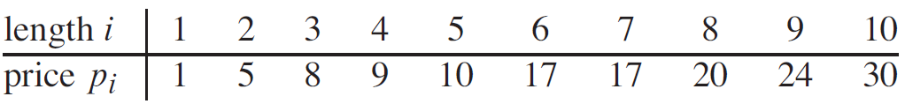
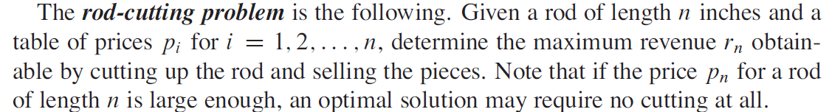
Rod Cutting
Sterling Enterprises buys long steel rods and cuts them into shorter rods
which it then sells.
Each cut is free. The management of Serling enterprises wants to know the best way to cut up the rods.

Slide 3
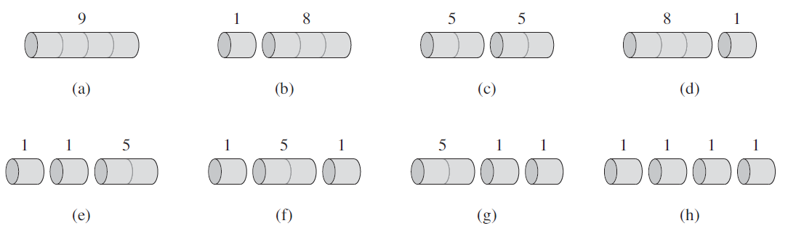
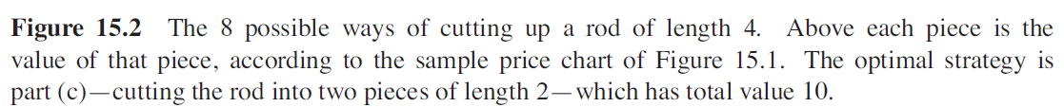
Rod Cutting

Slide 4
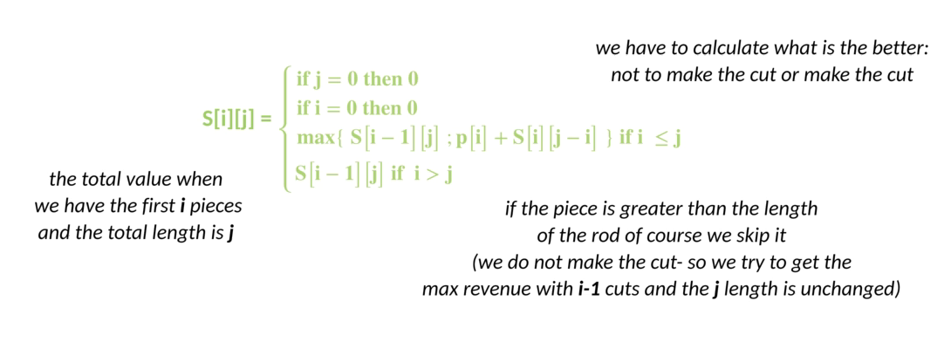
Rod Cutting

Slide 5
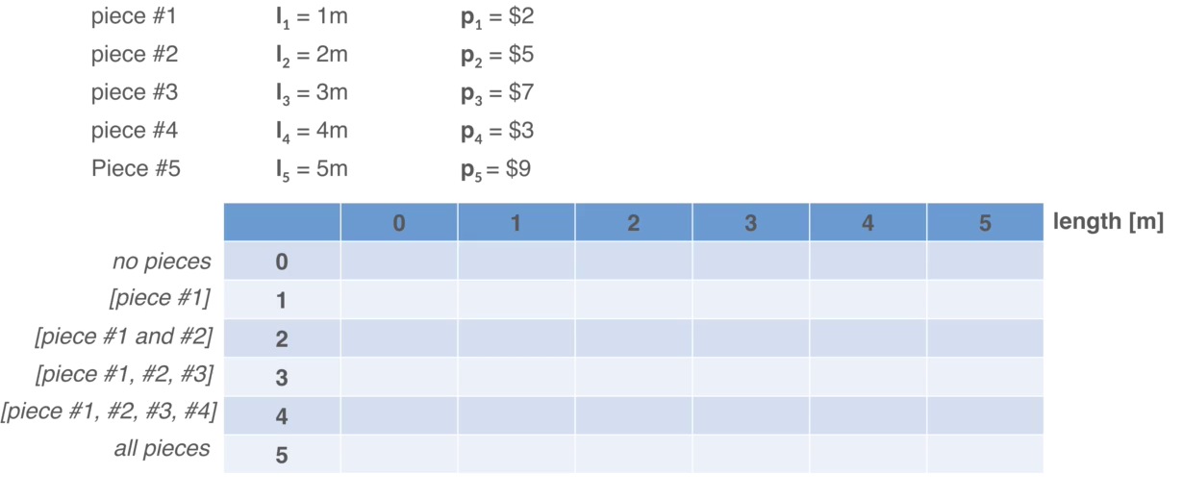
Rod Cutting
N = 5m

Slide 6
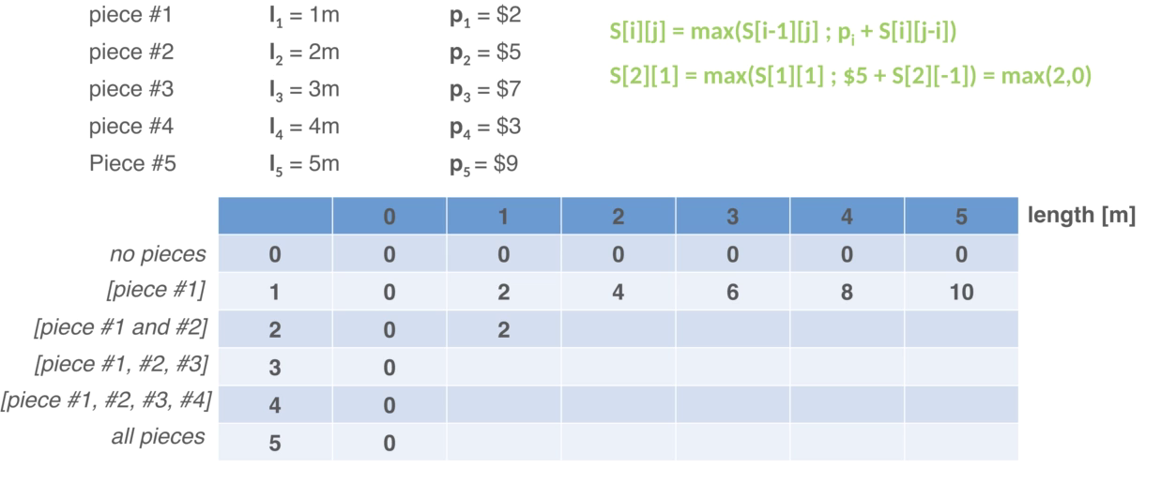
Rod Cutting
N = 5m

Slide 7
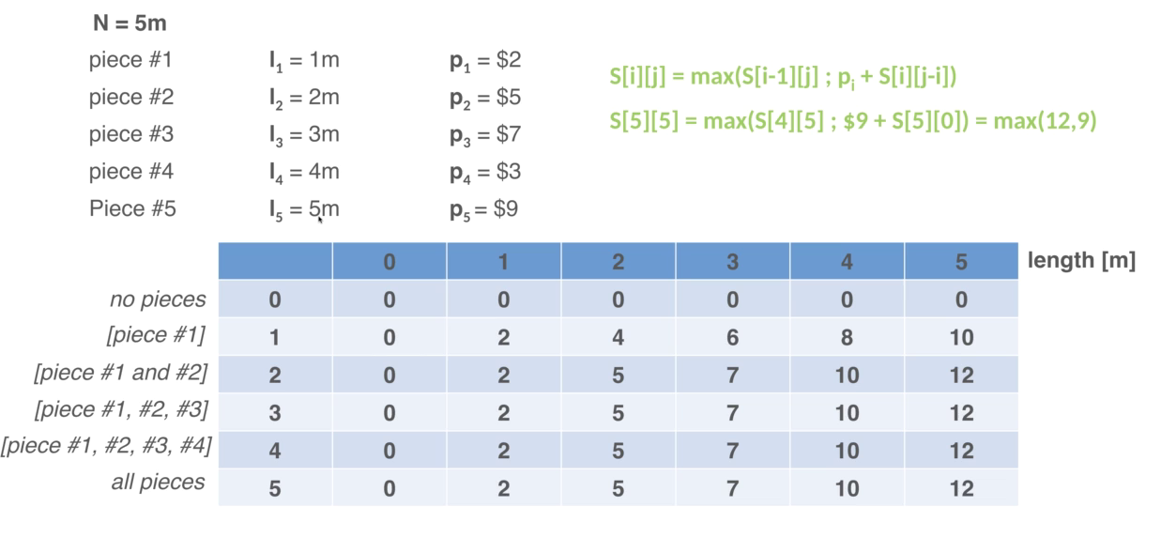
Rod Cutting - how to cut?

Slide 8
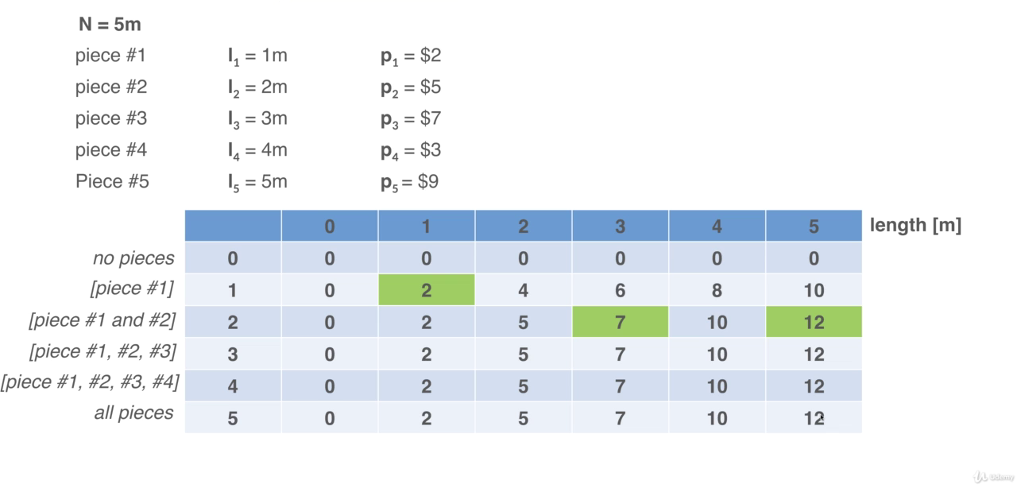
Rod Cutting - how to cut?

Slide 9
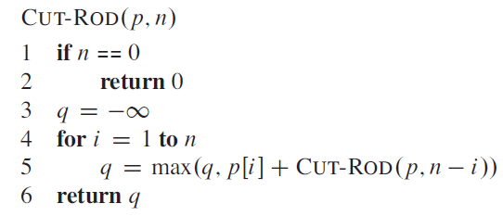
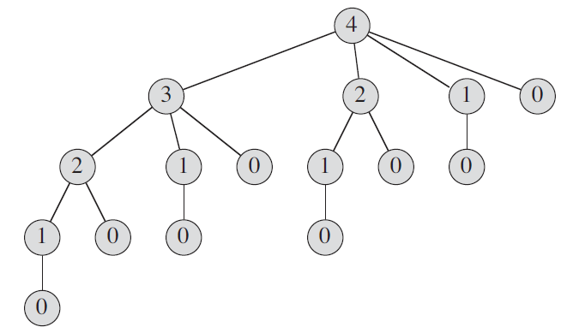
Rod Cutting
For n = 40, the program takes at least several minutes, and most likely more than an hour.
In fact, each time you increase n by 1, your program’s running time would approximately double.
this recursion tree has 2^{n} nodes and 2^{n-1} leaves.

Slide 10
Rod Cutting – using DP
The dynamic-programming method works as follows. Having observed that a naive recursive solution is inefficient because it solves the same subproblems repeatedly
we arrange for each subproblem to be solved only once, saving its solution.
If we need to refer to this subproblem’s solution again later, we can just look it up, rather than compute it.

Slide 11
Rod Cutting – using DP
Dynamic programming thus uses additional memory to save computation time; it serves an example of a time-memory trade-off.
The savings may be dramatic: an exponential-time solution may be transformed into a polynomial-time solution.
A dynamic-programming approach runs in polynomial time when the number of distinct subproblems involved is polynomial in the input size and we can solve each such subproblem in polynomial time.

Slide 12
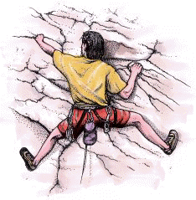
Rock Climbing Problem
A rock climber wants to get from the bottom of a rock to the top by the safest possible path.
At every step, he reaches for handholds above him; some holds are safer than other.
From every place, he can only reach a few nearest handholds.

Slide 13

Rock climbing (cont)
Suppose we have a wall instead of the rock.
5
3
4
2
At every step our climber can reach exactly three handholds: above, above and to the right and above and to the left.
There is a table of “danger ratings” provided. The “Danger” of a path is the sum of danger ratings of all handholds on the path.

Slide 14
Rock Climbing (cont)
We represent the wall as a table.
Every cell of the table contains the danger rating of the corresponding block.
2 | 8 | 9 | 5 | 8
4 | 4 | 6 | 2 | 3
5 | 7 | 5 | 6 | 1
3 | 2 | 5 | 4 | 8
2
5
4
2
5
1
2
4
The obvious greedy algorithm does not give an
optimal solution.
The rating of this path is 13.
The rating of an optimal path is 12.
However, we can solve this problem by a dynamic programming strategy in polynomial time.

Slide 15
Idea: once we know the rating of a path to every handhold on a layer, we can easily compute the ratings of the paths to the holds on the next layer.
For the top layer, that gives us an answer to the problem itself.

Slide 16
For every handhold, there is only one “path” rating. Once we have reached a hold, we don’t need to know how we got there to move to the next level.
This is called an “optimal substructure” property. Once we know optimal solutions to subproblems, we can compute an optimal solution to the problem itself.

Slide 17
Recursive solution:
To find the best way to get to stone j in row i, check the cost of getting to the stones
(i-1,j-1),
(i-1,j) and
(i-1,j+1), and take the cheapest.
Problem: each recursion level makes three calls for itself, making a total of 3^{n} calls – too much!

Slide 18
Solution - memorization
We query the value of A(i,j) over and over again.
Instead of computing it each time, we can compute it once, and remember the value.
A simple recurrence allows us to compute A(i,j) from values below.

Slide 19
Dynamic programming
Step 1: Describe an array of values you want to compute.
Step 2: Give a recurrence for computing later values from earlier (bottom-up).
Step 3: Give a high-level program.
Step 4: Show how to use values in the array to compute an optimal solution.

Slide 20
Rock climbing: step 1.
Step 1: Describe an array of values you want to compute.
For 1 ≤ i ≤ n and 1 ≤ j ≤ m, define A(i,j) to be the cumulative rating of the least dangerous path from the bottom to the hold (i,j).
The rating of the best path to the top will be the minimal value in the last row of the array.

Slide 21
Rock climbing: step 2.
Step 2: Give a recurrence for computing later values from earlier (bottom-up).
Let C(i,j) be the rating of the hold (i,j). There are three cases for A(i,j):
Left (j=1): C(i,j)+min{A(i-1,j),A(i-1,j+1)}
Right (j=m): C(i,j)+min{A(i-1,j-1),A(i-1,j)}
Middle: C(i,j)+min{A(i-1,j-1),A(i-1,j),A(i-1,j+1)}
For the first row (i=1), A(i,j)=C(i,j).

Slide 22
Rock climbing: simpler step 2
Add initialization row: A(0,j)=0. No danger to stand on the ground.
Add two initialization columns: A(i,0)=A(i,m+1)=∞. It is infinitely dangerous to try to hold on to the air where the wall ends.
Now the recurrence becomes, for every i,j:
A(i,j) = C(i,j)+min{A(i-1,j-1),A(i-1,j),A(i-1,j+1)}

Slide 23
Rock climbing: example
C(i,j):
A(i,j):
3 | 2 | 5 | 4 | 8
5 | 7 | 5 | 6 | 1
4 | 4 | 6 | 2 | 3
2 | 8 | 9 | 5 | 8
i\j | 0 | 1 | 2 | 3 | 4 | 5 | 6
0
1
2
3
4
i\j | 0 | 1 | 2 | 3 | 4 | 5 | 6
0 | ∞ | 0 | 0 | 0 | 0 | 0 | ∞
1 | ∞ |  |  |  |  |  | ∞
2 | ∞ |  |  |  |  |  | ∞
3 | ∞ |  |  |  |  |  | ∞
4 | ∞ |  |  |  |  |  | ∞
Initialization: A(i,0)=A(i,m+1)=∞, A(0,j)=0

Slide 24
Rock climbing: example
C(i,j):
A(i,j):
3 | 2 | 5 | 4 | 8
5 | 7 | 5 | 6 | 1
4 | 4 | 6 | 2 | 3
2 | 8 | 9 | 5 | 8
i\j | 0 | 1 | 2 | 3 | 4 | 5 | 6
0 | ∞ | 0 | 0 | 0 | 0 | 0 | ∞
1 | ∞ | 3 | 2 | 5 | 4 | 8 | ∞
2 | ∞ |  |  |  |  |  | ∞
3 | ∞ |  |  |  |  |  | ∞
4 | ∞ |  |  |  |  |  | ∞
i\j | 0 | 1 | 2 | 3 | 4 | 5 | 6
0 | ∞ | 0 | 0 | 0 | 0 | 0 | ∞
1 | ∞ |  |  |  |  |  | ∞
2 | ∞ |  |  |  |  |  | ∞
3 | ∞ |  |  |  |  |  | ∞
4 | ∞ |  |  |  |  |  | ∞
The values in the first row are the same as C(i,j).

Slide 25
Rock climbing: example
C(i,j):
A(i,j):
3 | 2 | 5 | 4 | 8
5 | 7 | 5 | 6 | 1
4 | 4 | 6 | 2 | 3
2 | 8 | 9 | 5 | 8
i\j | 0 | 1 | 2 | 3 | 4 | 5 | 6
0 | ∞ | 0 | 0 | 0 | 0 | 0 | ∞
1 | ∞ | 3 | 2 | 5 | 4 | 8 | ∞
2 | ∞ | 7 |  |  |  |  | ∞
3 | ∞ |  |  |  |  |  | ∞
4 | ∞ |  |  |  |  |  | ∞
A(2,1)=5+min{∞,3,2}=7.

Slide 26
Rock climbing: example
C(i,j):
A(i,j):
3 | 2 | 5 | 4 | 8
5 | 7 | 5 | 6 | 1
4 | 4 | 6 | 2 | 3
2 | 8 | 9 | 5 | 8
i\j | 0 | 1 | 2 | 3 | 4 | 5 | 6
0 | ∞ | 0 | 0 | 0 | 0 | 0 | ∞
1 | ∞ | 3 | 2 | 5 | 4 | 8 | ∞
2 | ∞ | 7 | 9 |  |  |  | ∞
3 | ∞ |  |  |  |  |  | ∞
4 | ∞ |  |  |  |  |  | ∞
A(2,1)=5+min{∞,3,2}=7. A(2,2)=7+min{3,2,5}=9

Slide 27
Rock climbing: example
C(i,j):
A(i,j):
3 | 2 | 5 | 4 | 8
5 | 7 | 5 | 6 | 1
4 | 4 | 6 | 2 | 3
2 | 8 | 9 | 5 | 8
i\j | 0 | 1 | 2 | 3 | 4 | 5 | 6
0 | ∞ | 0 | 0 | 0 | 0 | 0 | ∞
1 | ∞ | 3 | 2 | 5 | 4 | 8 | ∞
2 | ∞ | 7 | 9 | 7 |  |  | ∞
3 | ∞ |  |  |  |  |  | ∞
4 | ∞ |  |  |  |  |  | ∞
A(2,1)=5+min{∞,3,2}=7. A(2,2)=7+min{3,2,5}=9
A(2,3)=5+min{2,5,4}=7.

Slide 28
Rock climbing: example
C(i,j):
A(i,j):
3 | 2 | 5 | 4 | 8
5 | 7 | 5 | 6 | 1
4 | 4 | 6 | 2 | 3
2 | 8 | 9 | 5 | 8
i\j | 0 | 1 | 2 | 3 | 4 | 5 | 6
0 | ∞ | 0 | 0 | 0 | 0 | 0 | ∞
1 | ∞ | 3 | 2 | 5 | 4 | 8 | ∞
2 | ∞ | 7 | 9 | 7 | 10 | 5 | ∞
3 | ∞ |  |  |  |  |  | ∞
4 | ∞ |  |  |  |  |  | ∞
The best cumulative rating on the second row is 5.

Slide 29
Rock climbing: example
C(i,j):
A(i,j):
3 | 2 | 5 | 4 | 8
5 | 7 | 5 | 6 | 1
4 | 4 | 6 | 2 | 3
2 | 8 | 9 | 5 | 8
i\j | 0 | 1 | 2 | 3 | 4 | 5 | 6
0 | ∞ | 0 | 0 | 0 | 0 | 0 | ∞
1 | ∞ | 3 | 2 | 5 | 4 | 8 | ∞
2 | ∞ | 7 | 9 | 7 | 10 | 5 | ∞
3 | ∞ | 11 | 11 | 13 | 7 | 8 | ∞
4 | ∞ |  |  |  |  |  | ∞
The best cumulative rating on the third row is 7.

Slide 30
Rock climbing: example
C(i,j):
A(i,j):
3 | 2 | 5 | 4 | 8
5 | 7 | 5 | 6 | 1
4 | 4 | 6 | 2 | 3
2 | 8 | 9 | 5 | 8
i\j | 0 | 1 | 2 | 3 | 4 | 5 | 6
0 | ∞ | 0 | 0 | 0 | 0 | 0 | ∞
1 | ∞ | 3 | 2 | 5 | 4 | 8 | ∞
2 | ∞ | 7 | 9 | 7 | 10 | 5 | ∞
3 | ∞ | 11 | 11 | 13 | 7 | 8 | ∞
4 | ∞ | 13 | 19 | 16 | 12 | 15 | ∞
The best cumulative rating on the last row is 12.

Slide 31
Rock climbing: example
C(i,j):
A(i,j):
3 | 2 | 5 | 4 | 8
5 | 7 | 5 | 6 | 1
4 | 4 | 6 | 2 | 3
2 | 8 | 9 | 5 | 8
i\j | 0 | 1 | 2 | 3 | 4 | 5 | 6
0 | ∞ | 0 | 0 | 0 | 0 | 0 | ∞
1 | ∞ | 3 | 2 | 5 | 4 | 8 | ∞
2 | ∞ | 7 | 9 | 7 | 10 | 5 | ∞
3 | ∞ | 11 | 11 | 13 | 7 | 8 | ∞
4 | ∞ | 13 | 19 | 16 | 12 | 15 | ∞
The best cumulative rating on the last row is 12.
So the rating of the best path to the top is 12.

Slide 32
Rock climbing example: step 4
C(i,j):
A(i,j):
3 | 2 | 5 | 4 | 8
5 | 7 | 5 | 6 | 1
4 | 4 | 6 | 2 | 3
2 | 8 | 9 | 5 | 8
i\j | 0 | 1 | 2 | 3 | 4 | 5 | 6
0 | ∞ | 0 | 0 | 0 | 0 | 0 | ∞
1 | ∞ | 3 | 2 | 5 | 4 | 8 | ∞
2 | ∞ | 7 | 9 | 7 | 10 | 5 | ∞
3 | ∞ | 11 | 11 | 13 | 7 | 8 | ∞
4 | ∞ | 13 | 19 | 16 | 12 | 15 | ∞
To find the actual path we need to retrace backwards
the decisions made during the calculation of A(i,j).

Slide 33
Rock climbing example: step 4
C(i,j):
A(i,j):
i\j | 0 | 1 | 2 | 3 | 4 | 5 | 6
0 | ∞ | 0 | 0 | 0 | 0 | 0 | ∞
1 | ∞ | 3 | 2 | 5 | 4 | 8 | ∞
2 | ∞ | 7 | 9 | 7 | 10 | 5 | ∞
3 | ∞ | 11 | 11 | 13 | 7 | 8 | ∞
4 | ∞ | 13 | 19 | 16 | 12 | 15 | ∞
3 | 2 | 5 | 4 | 8
5 | 7 | 5 | 6 | 1
4 | 4 | 6 | 2 | 3
2 | 8 | 9 | 5 | 8
The last hold was (4,4).
To find the actual path we need to retrace backwards
the decisions made during the calculation of A(i,j).

Slide 34
Rock climbing example: step 4
C(i,j):
A(i,j):
i\j | 0 | 1 | 2 | 3 | 4 | 5 | 6
0 | ∞ | 0 | 0 | 0 | 0 | 0 | ∞
1 | ∞ | 3 | 2 | 5 | 4 | 8 | ∞
2 | ∞ | 7 | 9 | 7 | 10 | 5 | ∞
3 | ∞ | 11 | 11 | 13 | 7 | 8 | ∞
4 | ∞ | 13 | 19 | 16 | 12 | 15 | ∞
3 | 2 | 5 | 4 | 8
5 | 7 | 5 | 6 | 1
4 | 4 | 6 | 2 | 3
2 | 8 | 9 | 5 | 8
The hold before the last
was (3,4), since
min{13,7,8} was 7.
To find the actual path we need to retrace backwards
the decisions made during the calculation of A(i,j).

Slide 35
Rock climbing example: step 4
C(i,j):
A(i,j):
i\j | 0 | 1 | 2 | 3 | 4 | 5 | 6
0 | ∞ | 0 | 0 | 0 | 0 | 0 | ∞
1 | ∞ | 3 | 2 | 5 | 4 | 8 | ∞
2 | ∞ | 7 | 9 | 7 | 10 | 5 | ∞
3 | ∞ | 11 | 11 | 13 | 7 | 8 | ∞
4 | ∞ | 13 | 19 | 16 | 12 | 15 | ∞
3 | 2 | 5 | 4 | 8
5 | 7 | 5 | 6 | 1
4 | 4 | 6 | 2 | 3
2 | 8 | 9 | 5 | 8
The hold before that
was (2,5), since
min{7,10,5} was 5.
To find the actual path we need to retrace backwards
the decisions made during the calculation of A(i,j).

Slide 36
Rock climbing example: step 4
C(i,j):
A(i,j):
i\j | 0 | 1 | 2 | 3 | 4 | 5 | 6
0 | ∞ | 0 | 0 | 0 | 0 | 0 | ∞
1 | ∞ | 3 | 2 | 5 | 4 | 8 | ∞
2 | ∞ | 7 | 9 | 7 | 10 | 5 | ∞
3 | ∞ | 11 | 11 | 13 | 7 | 8 | ∞
4 | ∞ | 13 | 19 | 16 | 12 | 15 | ∞
3 | 2 | 5 | 4 | 8
5 | 7 | 5 | 6 | 1
4 | 4 | 6 | 2 | 3
2 | 8 | 9 | 5 | 8
Finally, the first hold
was (1,4), since
min{5,4,8} was 4.
To find the actual path we need to retrace backwards
the decisions made during the calculation of A(i,j).

Slide 37
Rock climbing example: step 4
C(i,j):
A(i,j):
i\j | 0 | 1 | 2 | 3 | 4 | 5 | 6
0 | ∞ | 0 | 0 | 0 | 0 | 0 | ∞
1 | ∞ | 3 | 2 | 5 | 4 | 8 | ∞
2 | ∞ | 7 | 9 | 7 | 10 | 5 | ∞
3 | ∞ | 11 | 11 | 13 | 7 | 8 | ∞
4 | ∞ | 13 | 19 | 16 | 12 | 15 | ∞
3 | 2 | 5 | 4 | 8
5 | 7 | 5 | 6 | 1
4 | 4 | 6 | 2 | 3
2 | 8 | 9 | 5 | 8
We are done!

Slide 38
Printing out the solution recursively
PrintBest(A,i,j) // Printing the best path ending at (i,j)
if (i==0) OR (j=0) OR (j=m+1)
return;
if (A[i-1,j-1]<=A[i-1,j]) AND (A[i-1,j-1]<=A[i-1,j+1])
PrintBest(A,i-1,j-1);
elseif (A[i-1,j]<=A[i-1,j-1]) AND (A[i-1,j]<=A[i-1,j+1])
PrintBest(A,i-1,j);
elseif (A[i-1,j+1]<=A[i-1,j-1]) AND (A[i-1,j+1]<=A[i-1,j])
PrintBest(A,i-1,j+1);
printf(i,j)

Slide 39
Sum of Subset Problem
Problem:
Suppose you are given N positive integer numbers A[1…N] and it is required to produce another number K using a subset of A[1..N] numbers. How can it be done using Dynamic programming approach?
Example:
N = 6, A[1..N] = {2, 5, 8, 12, 6, 14}, K = 19
Result: 2 + 5 + 12 = 19

Slide 40
Coin Change Problem
Suppose you are given n types of coin - C₁, C₂, … , C_{n} coin, and another number K.
Is it possible to make K using above types of coin?
Number of each coin is infinite
Number of each coin is finite
Find minimum number of coin that is required to make K?
Number of each coin is infinite
Number of each coin is finite

Slide 41
Maximum-sum interval
Given a sequence of real numbers a₁a₂…a_{n} , find a consecutive subsequence with the maximum sum.
9 –3 1 7 –15 2 3 –4 2 –7 6 –2 8 4 -9
For each position, we can compute the maximum-sum interval starting at that position in O(n) time. Therefore, a naive algorithm runs in O(n²) time.
Try Yourself

